Slide 1

Logistic Regression

Slide 2
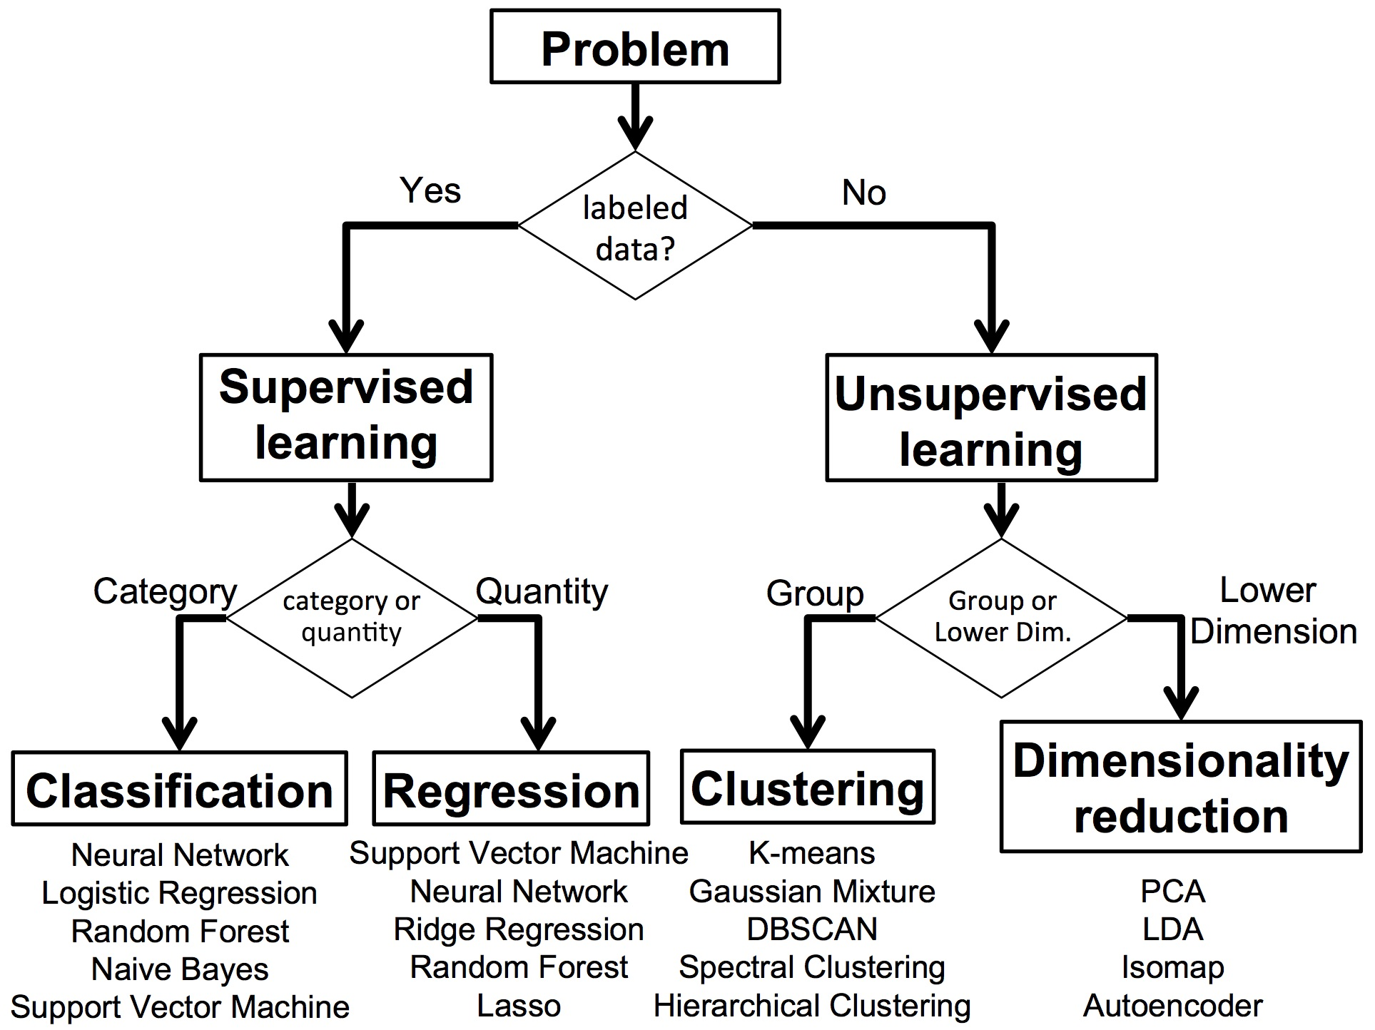

Slide 3
Steps in ML
1. Data collection
2. Data preparation
3. Choose a ML model
4. Train the model
5. Evaluate the model
7. Make predictions
6. Parameter tuning

Slide 4
Introduction to Classification
INSURANCE CLAIM ANALYSIS
Introduction to Logistic Regression
Sigmoid Function
Confusion Matrix
Classification Evaluation Metrics
https://www.kaggle.com/code/prashant111/logistic-regression-classifier-tutorial

Slide 5
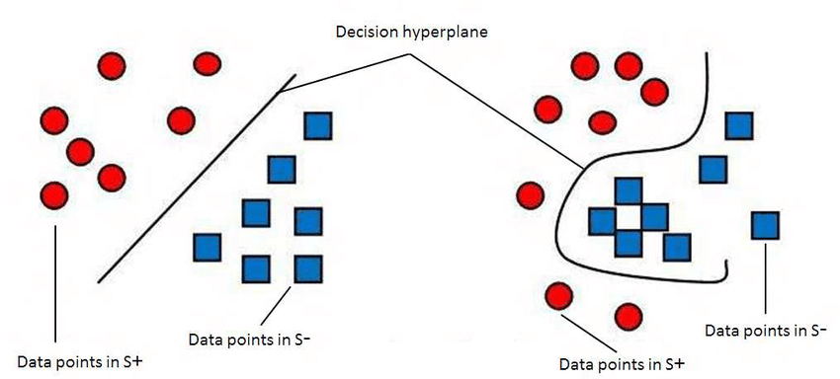
Linear Classifiers
Linear models create a linear decision boundary between classes. They are simple and computationally efficient. Some of the linear classification models are as follows:
Logistic Regression
Support Vector Machines having kernel = ‘linear’
Single-layer Perceptron
Stochastic Gradient Descent (SGD) Classifier
Non-linear Classifiers
Non-linear models create a non-linear decision boundary between classes. They can capture more complex relationships between the input features and the target variable. Some of the non-linear classification models are as follows:
K-Nearest Neighbours
Kernel SVM
Naive Bayes
Decision Tree Classification
Ensemble learning classifiers:
Random Forests,
AdaBoost,
Bagging Classifier,
Voting Classifier,
Multi-layer Artificial Neural Networks

Slide 6
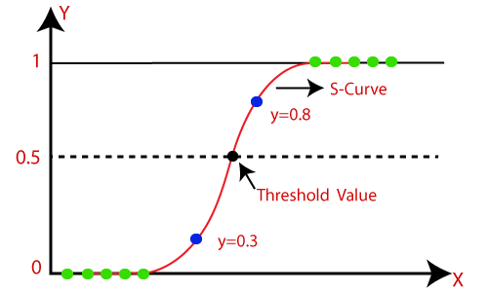
Logistic Regression
Introduction to Logistic Regression
Sigmoid Function
Confusion Matrix
Classification Evaluation Metrics
Logistic regression predicts the output of a categorical dependent variable.
Therefore the outcome must be a categorical or discrete value.
It can be either Yes or No, 0 or 1, true or False, etc. but instead of giving the exact value as 0 and 1, it gives the probabilistic values which lie between 0 and 1.
https://datahacker.rs/004-machine-learning-logistic-regression-model/
Assumptions for Logistic Regression:
The dependent variable must be categorical in nature.
The independent variable should not have multi-collinearity.

Slide 7
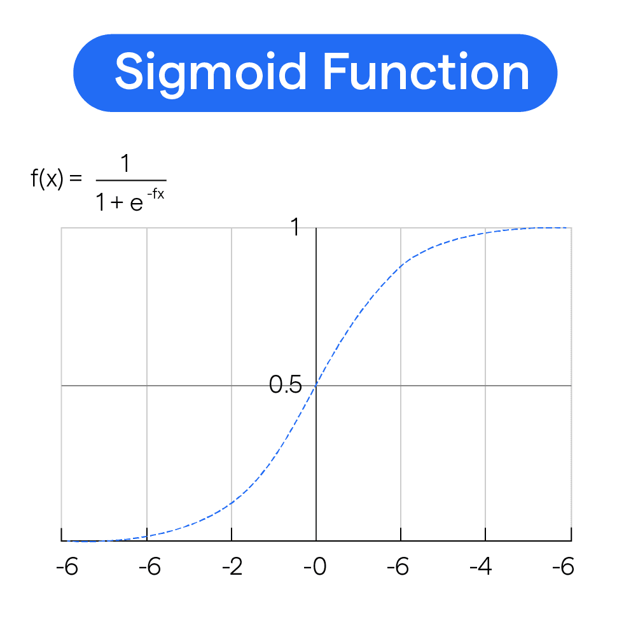
Logistic Function (Sigmoid Function):
The sigmoid function is a mathematical function used to map the predicted values to probabilities.
It maps any real value into another value within a range of 0 and 1.
The value of the logistic regression must be between 0 and 1, which cannot go beyond this limit, so it forms a curve like the "S" form. The S-form curve is called the Sigmoid function or the logistic function.
In logistic regression, we use the concept of the threshold value, which defines the probability of either 0 or 1. Such as values above the threshold value tends to 1, and a value below the threshold values tends to 0.

Slide 8
Type of Logistic Regression:
On the basis of the categories, Logistic Regression can be classified into three types:
Binomial: In binomial Logistic regression, there can be only two possible types of the dependent variables, such as 0 or 1, Pass or Fail, etc.
Multinomial: In multinomial Logistic regression, there can be 3 or more possible unordered types of the dependent variable, such as "cat", "dogs", or "sheep"
Ordinal: In ordinal Logistic regression, there can be 3 or more possible ordered types of dependent variables, such as "low", "Medium", or "High".
#Fitting Logistic Regression to the training set
from sklearn.linear_model import LogisticRegression
classifier= LogisticRegression(random_state=0)
classifier.fit(x_train, y_train)

Slide 9
Cost functions/loss function in logistic regression
Log loss
L1 (feature selection ,lasso)and L2(reduction overfitting ridge) regularization
C & lambda relationship (lambda is hyper parameter )

Slide 10
Model evaluation
Model evaluation is like giving them a test to see if they truly learned the subject—or just memorized answers. It helps us answer:
Did the model learn patterns?
Will it fail on new questions?

Slide 11
Classification Metrics in Machine Learning
Accuracy The Limitations of Accuracy
Example of Limitation of Accuracy
What is Confusion Matrix?
Precision
Recall (Sensitivity)
F1 Score
AUC-ROC
Log Loss
Conclusion

Slide 12
Classification Models in Machine Learning
Evaluating a classification model is an important step in machine learning, as it helps to assess the performance and generalization ability of the model on new, unseen data. There are several metrics and techniques that can be used to evaluate a classification model, depending on the specific problem and requirements. Here are some commonly used evaluation metrics:
Classification Accuracy: The proportion of correctly classified instances over the total number of instances in the test set. It is a simple and intuitive metric but can be misleading in imbalanced datasets where the majority class dominates the accuracy score.
Confusion matrix: A table that shows the number of true positives, true negatives, false positives, and false negatives for each class, which can be used to calculate various evaluation metrics.
Precision and Recall: Precision measures the proportion of true positives over the total number of predicted positives, while recall measures the proportion of true positives over the total number of actual positives. These metrics are useful in scenarios where one class is more important than the other, or when there is a trade-off between false positives and false negatives.
F1-Score: The harmonic mean of precision and recall, calculated as 2 x (precision x recall) / (precision + recall). It is a useful metric for imbalanced datasets where both precision and recall are important.
ROC curve and AUC: The Receiver Operating Characteristic (ROC) curve is a plot of the true positive rate (recall) against the false positive rate (1-specificity) for different threshold values of the classifier’s decision function. The Area Under the Curve (AUC) measures the overall performance of the classifier, with values ranging from 0.5 (random guessing) to 1 (perfect classification).
Cross-validation: A technique that divides the data into multiple folds and trains the model on each fold while testing on the others, to obtain a more robust estimate of the model’s performance.

Slide 13
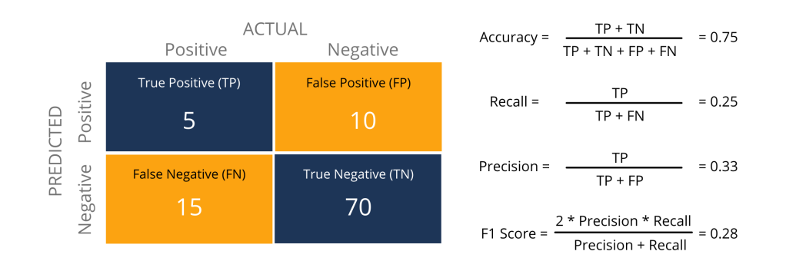
Metrics to Evaluate your Classification Model
https://www.analyticsvidhya.com/blog/2021/07/metrics-to-evaluate-your-classification-model-to-take-the-right-decisions/

Slide 14
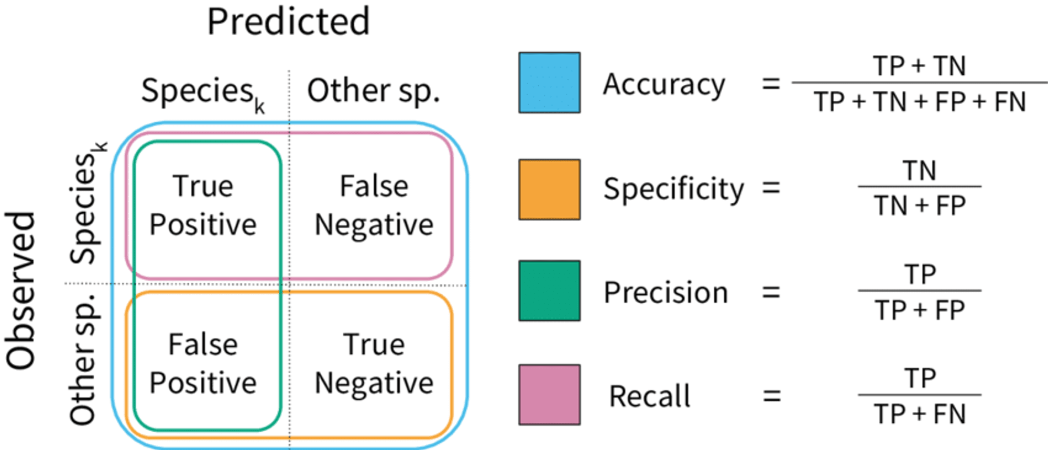
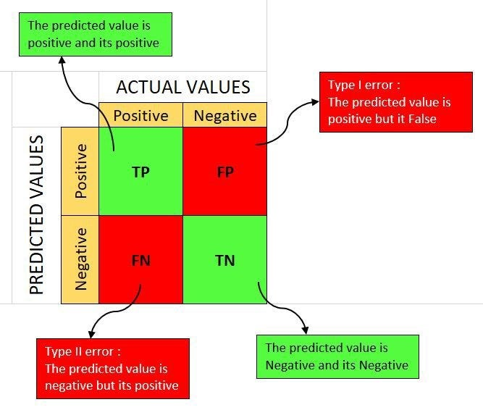

Slide 15
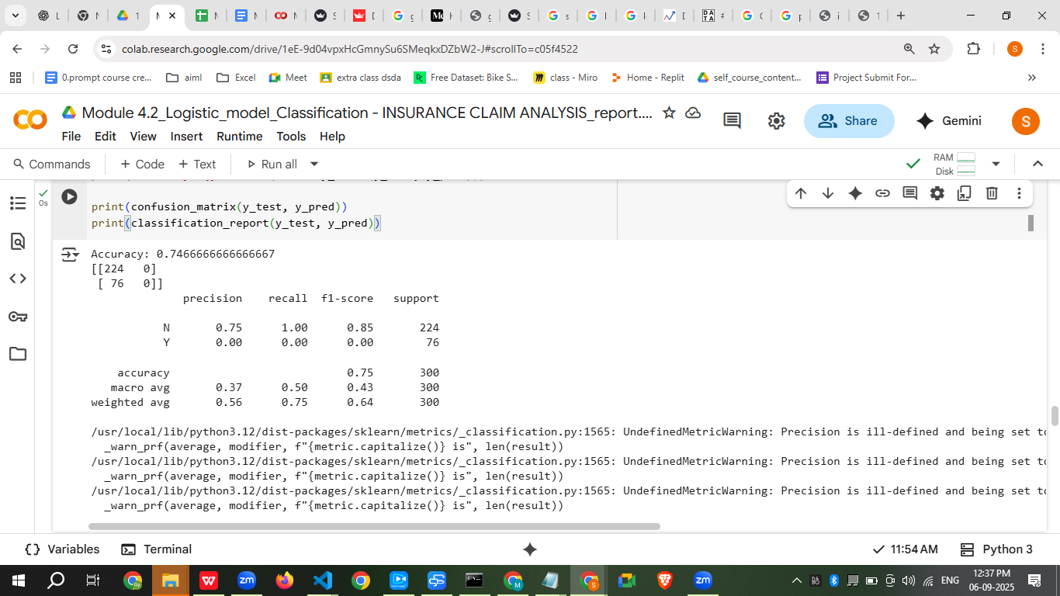
Predict
N
Y
N
TP
FP
Actual
Y
FP
TN

Slide 16
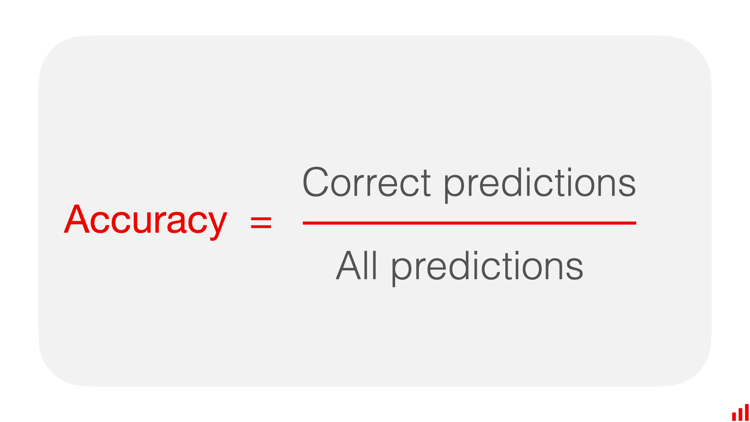
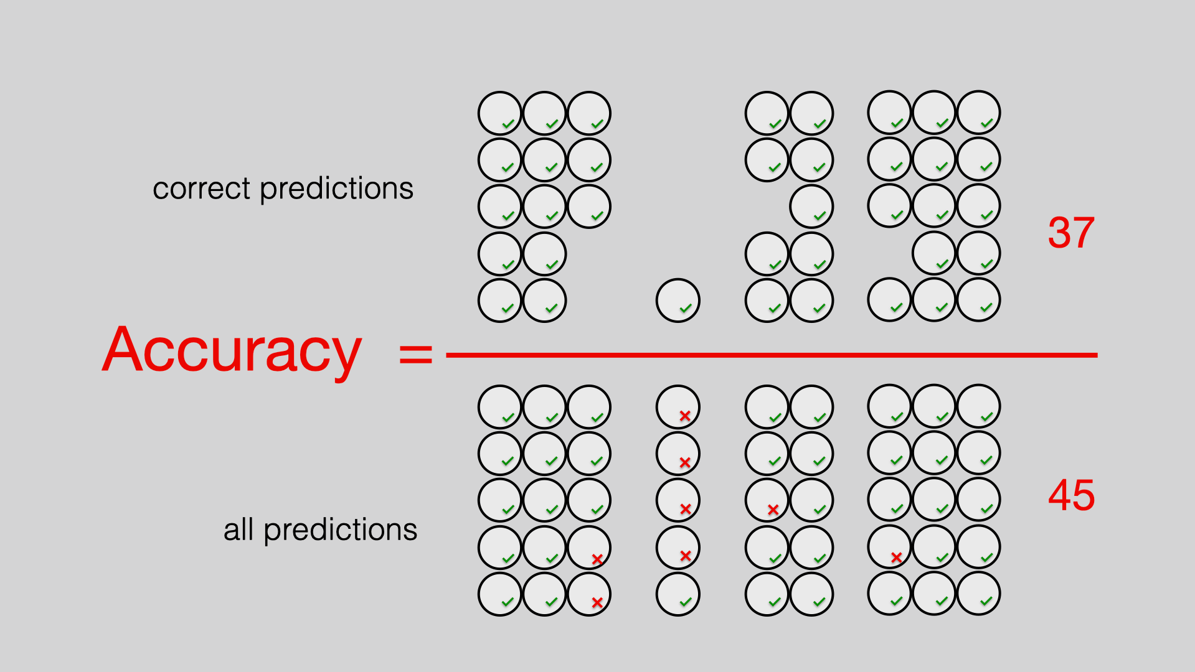
1. Accuracy
The ratio of correct predictions to the total number of predictions. It provides a general overview of the model's correctness but may not be sufficient when dealing with imbalanced datasets.

Slide 17
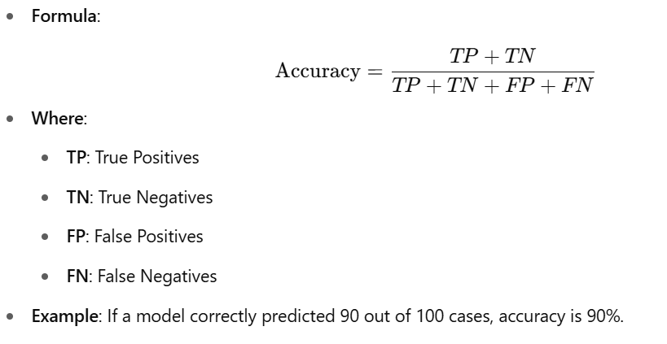
Actual Class | Predicted Class
Disease | No Disease
Disease | No Disease
Disease | No Disease
No Disease | No Disease
No Disease | No Disease
No Disease | No Disease
No Disease | No Disease
No Disease | No Disease
No Disease | No Disease
No Disease | No Disease
📉 3. Example of Limitation of Accuracy
Total = 10 cases (3 diseased, 7 healthy)
Model predicts all as "No Disease"
Accuracy = 7/10 = 70%
But recall for diseased patients = 0%, meaning not useful for diagnosis
⚠️ 2. Limitations of Accuracy
Accuracy can be misleading if the dataset is imbalanced.
Example:
Suppose in a medical test dataset, 95% of the patients are healthy (negative class), and 5% have a disease (positive class).
A model that predicts "healthy" for all cases will be 95% accurate, but it fails to identify any actual patients with the disease.

Slide 18
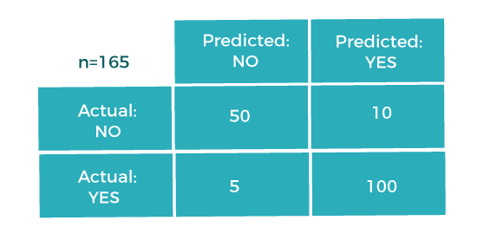
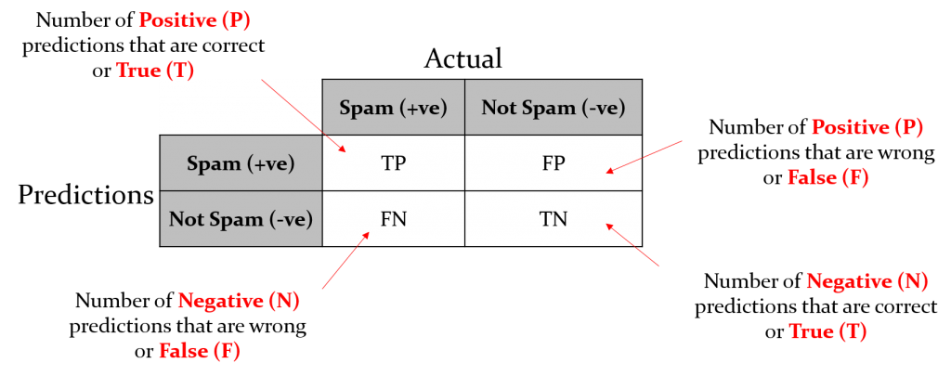
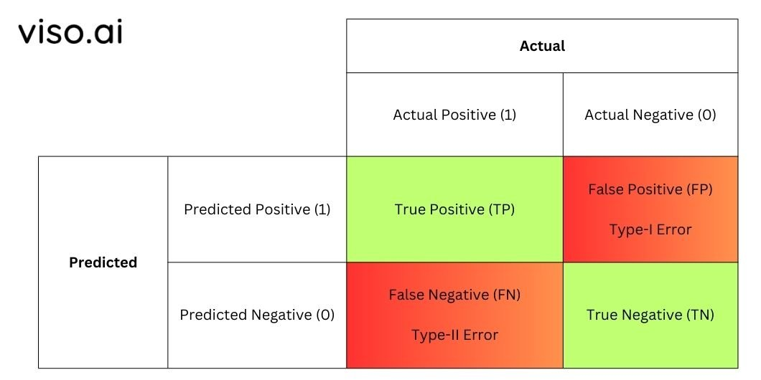
II. Confusion Matrix
confusion-matrix-machine-learning
What is Confusion Matrix?
A confusion matrix is a performance measurement tool for classification. It shows actual vs predicted classifications in a tabular form.
https://www.geeksforgeeks.org/confusion-matrix-machine-learning/

Slide 19
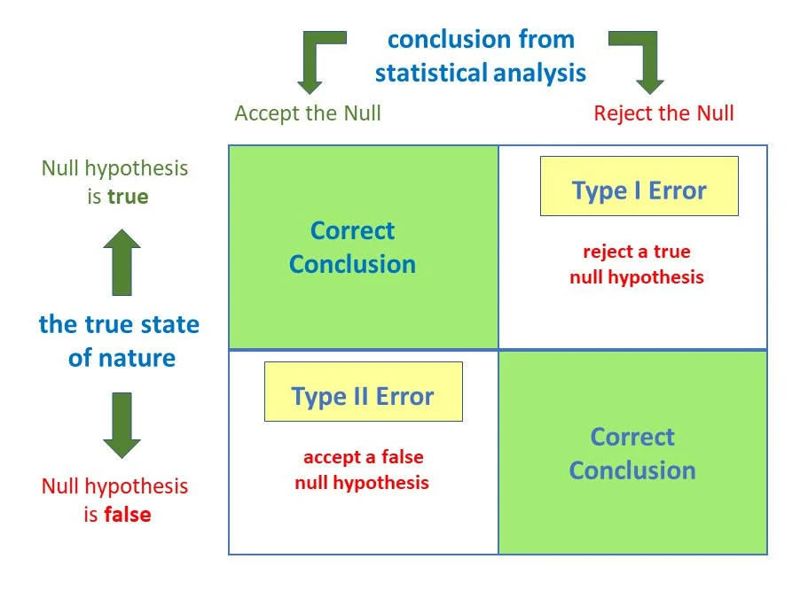

Slide 20

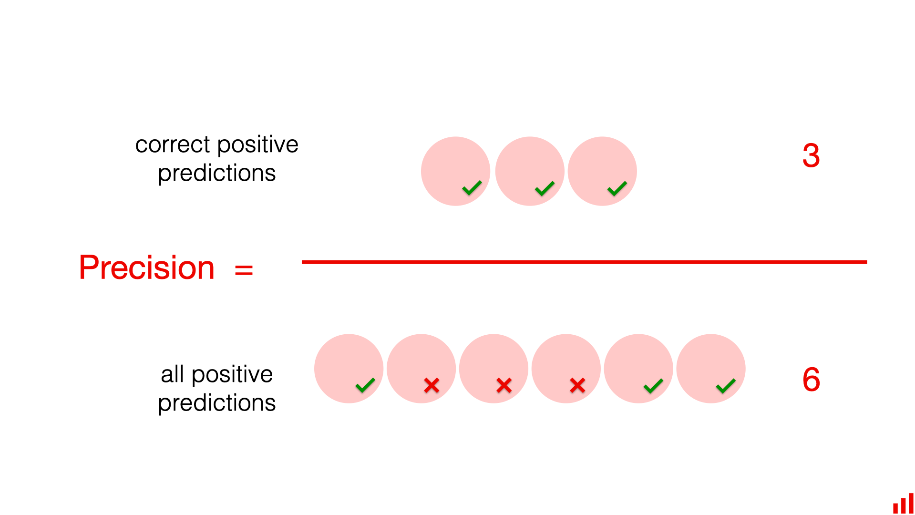
III. Precision
precision is a metric that evaluates the accuracy of a model's positive predictions.
It measures the proportion of correctly predicted positive instances out of all instances predicted as positive.
Essentially, it answers the question: "Of all the instances the model classified as positive, how many were actually positive?"
The precision metric is used to overcome the limitation of Accuracy. The precision determines the proportion of positive prediction that was actually correct.
Here's a breakdown:
True Positives (TP): Correctly predicted positive instances.
False Positives (FP): Incorrectly predicted positive instances (the model thought they were positive, but they were actually negative).
Precision Formula: Precision = TP / (TP + FP)
https://www.javatpoint.com/performance-metrics-in-machine-learning
https://www.kaggle.com/code/prashant111/logistic-regression-classifier-tutorial
Implementations with all in one

Slide 21
Example:
Imagine a spam filter. If the model flags 100 emails as spam, and 90 of them are actually spam (and 10 are incorrectly classified as spam), then the precision is 90/100 = 0.9 or 90%. This means 90% of the emails identified as spam were actually spam.
Importance of Precision:
High Precision is desirable when:
False positives are costly or undesirable. For instance, in medical diagnoses, you'd want a high precision for a test that identifies a disease, so as to avoid falsely alarming patients.
Precision and Recall Relationship:
Precision and recall often have an inverse relationship. Increasing precision can decrease recall, and vice versa. Therefore, it's crucial to consider both metrics when evaluating a model. In some cases, the F1-score, which combines precision and recall, is used to get a balanced evaluation.

Slide 22

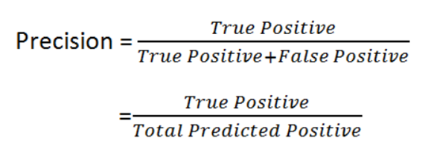
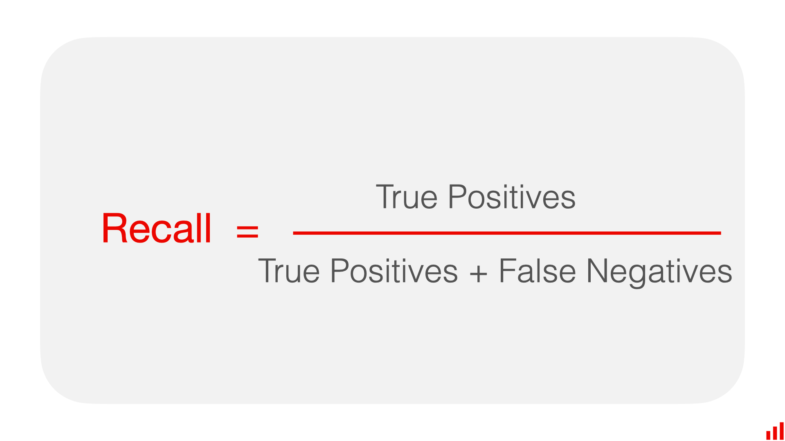
IV. Recall or Sensitivity
recall is a metric that measures the ability of a model to correctly identify all relevant instances (true positives) within a dataset. It focuses on minimizing false negatives, meaning the model is evaluated on how well it finds all the positive cases, even if it might also include some false positives.
Here's a breakdown:
True Positives (TP): The model correctly identifies positive cases.
False Negatives (FN): The model incorrectly identifies positive cases as negative.
Recall Formula: Recall = TP / (TP + FN).
Purpose: Recall is particularly important when the cost of missing a positive case (false negative) is high.
Example:
Imagine a medical test for a disease. A high recall means the test is good at identifying all patients who actually have the disease, even if it sometimes misclassifies healthy people as having the disease (false positives).
When to use recall:
Minimizing false negatives is crucial: In applications where missing a positive case has serious consequences.
The cost of acting on a false positive is low: If it's relatively easy to correct a false positive, high recall is desirable.
Example use cases: Fraud detection, medical diagnoses, and spam filtering.

Slide 23
F1-score
The F1 score is a metric used to evaluate the performance of machine learning models, particularly in classification tasks. It represents the harmonic mean of precision and recall, providing a balanced measure that considers both false positives and false negatives.
The F1-score combines these three metrics into one single metric that ranges from 0 to 1 and it takes into account both Precision and Recall.
Key Concepts:
Precision: Meets the proportion of correctly predicted positive cases out of all predicted positive cases.
Recall: Represents the proportion of correctly predicted positive cases out of all actual positive cases.
F1 Score: Calculated as 2 * (precision * recall) / (precision + recall).
Why use F1 Score?
Balanced Evaluation:
When you need a balanced evaluation of a model's performance, considering both false positives and false negatives.
Imbalanced Datasets:
It is particularly useful when dealing with imbalanced datasets where one class has significantly more instances than the other.
Avoiding Optimization Bias:
F1 score helps avoid optimizing solely for precision or recall, which can be misleading in certain scenarios.
Example:
In medical testing, a high F1 score indicates that the model is good at identifying patients with a disease (high recall) without incorrectly diagnosing healthy individuals as having the disease (high precision). Similarly, in fraud detection, the F1 score helps balance the need to catch fraudulent transactions while minimizing the number of false alarms.
Interpretation:
The F1 score ranges from 0 to 1, with 1 representing perfect precision and recall, and 0 representing the worst possible performance.

Slide 24
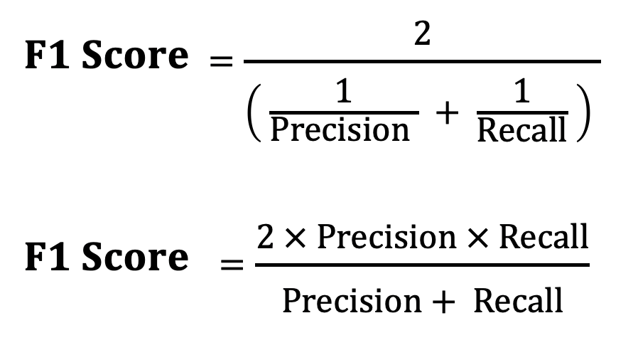

Slide 25
import numpy as np
import matplotlib.pyplot as plt
from sklearn.metrics import confusion_matrix, ConfusionMatrixDisplay
from sklearn.model_selection import train_test_split
from sklearn.datasets import load_iris
from sklearn.ensemble import RandomForestClassifier
# Load a sample dataset
data = load_iris()
X, y = data.data, data.target
# Split the dataset into training and testing sets
X_train, X_test, y_train, y_test = train_test_split(X, y, test_size=0.3, random_state=42)
# Train a classification model
model = RandomForestClassifier(random_state=42)
model.fit(X_train, y_train)
# Make predictions
y_pred = model.predict(X_test)
# Generate the confusion matrix
cm = confusion_matrix(y_test, y_pred)
# Display the confusion matrix
disp = ConfusionMatrixDisplay(confusion_matrix=cm, display_labels=data.target_names)
disp.plot(cmap=plt.cm.Blues)
plt.title("Confusion Matrix")
plt.show()
# Calculate evaluation metrics
TP = np.diag(cm) # True Positives
FP = np.sum(cm, axis=0) - TP # False Positives
FN = np.sum(cm, axis=1) - TP # False Negatives
precision = TP / (TP + FP)
recall = TP / (TP + FN)
f1_score = 2 * (precision * recall) / (precision + recall)
print("Precision:", precision)
print("Recall:", recall)
print("F1-Score:", f1_score)

Slide 26
Confusion Matrix
Understanding Performance:
Provides a detailed overview of a classification model’s performance beyond simple accuracy.
Highlights true positives, true negatives, false positives, and false negatives for deeper insights.
Use Case:
Medical Diagnostics: Identifies how many actual diseases were correctly diagnosed (true positives) vs. missed diagnoses (false negatives).
Precision, Recall, and F1-Score
Precision:
Measures the accuracy of positive predictions, crucial when false positives are costly.
Use Case:
Fraud Detection: High precision ensures that few legitimate transactions are incorrectly flagged as fraud.
Recall:
Assesses the model's ability to identify all relevant instances, vital in minimizing false negatives.
Use Case:
Spam Detection: High recall ensures that most spam emails are captured, reducing user exposure to unwanted content.
F1-Score:
Combines precision and recall into a single metric, particularly useful in imbalanced datasets.
Use Case:
Customer Churn Prediction: Balances the need to accurately predict both churn and non-churn customers in a highly imbalanced dataset.

Slide 27
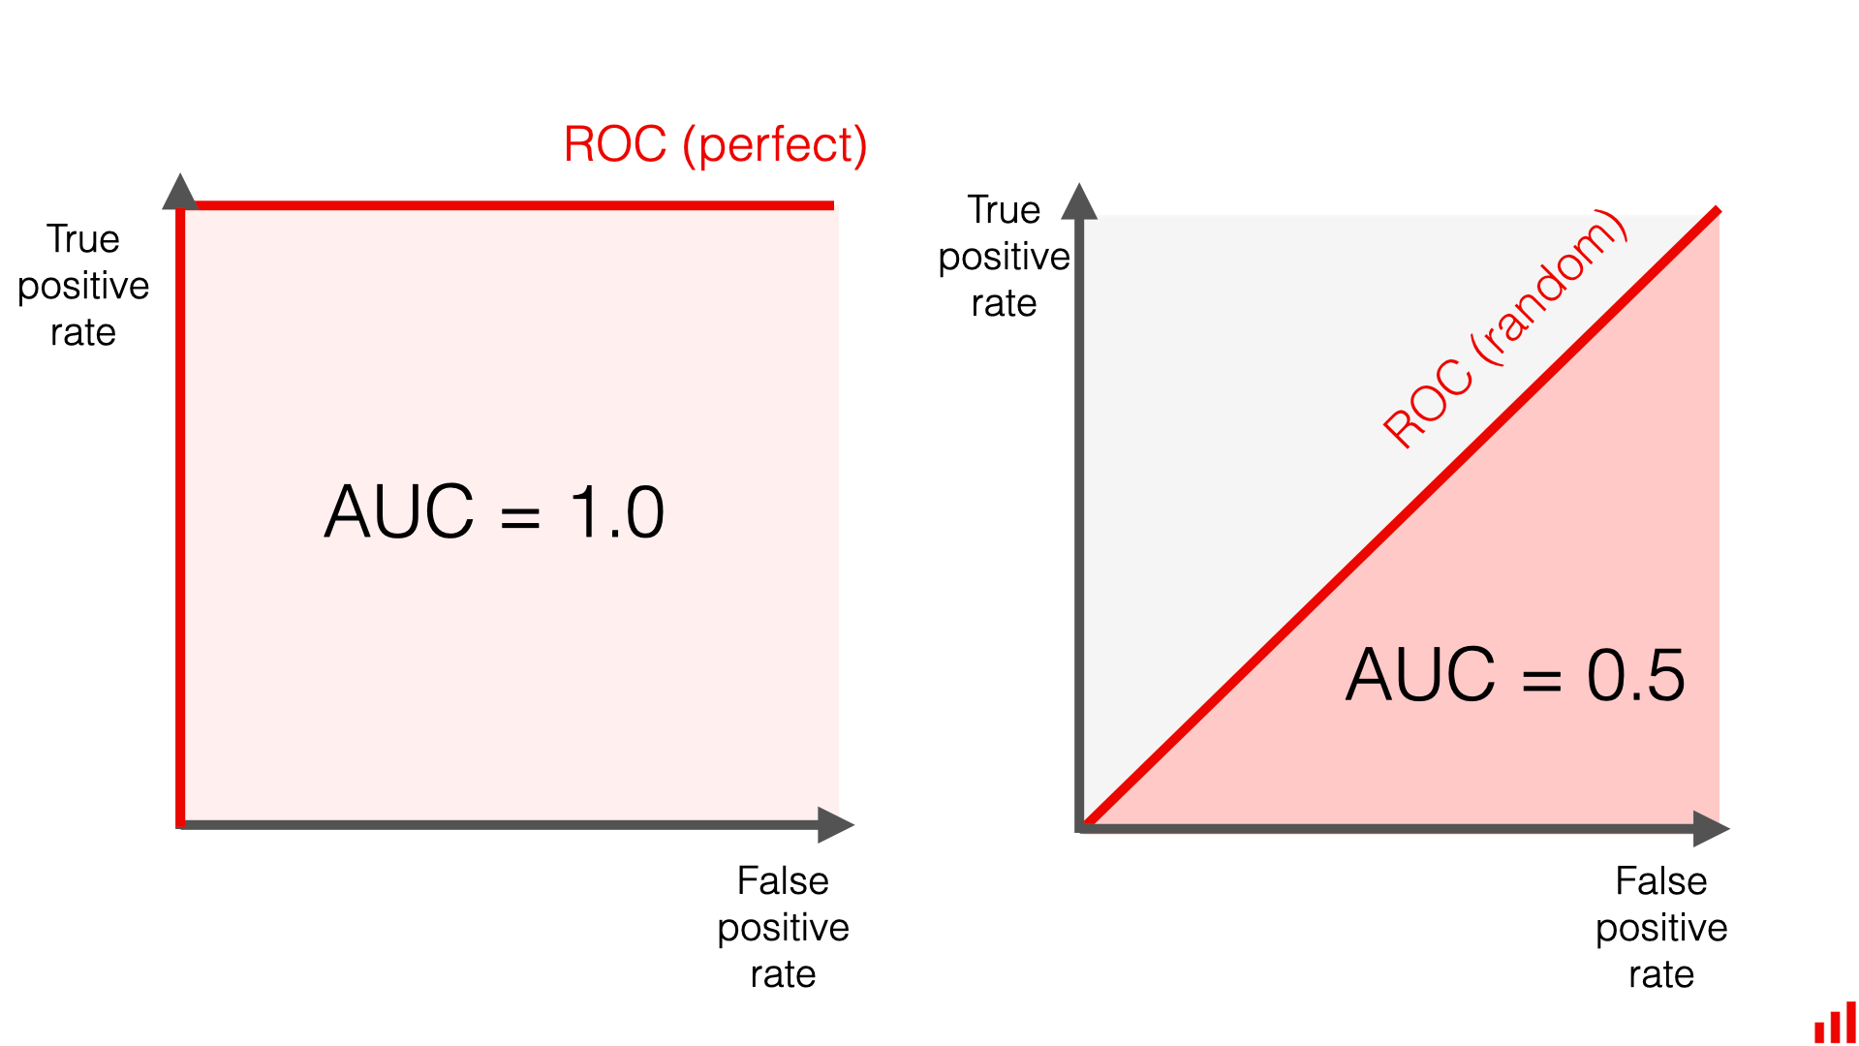
ROC Curve and AUC
ROC Curve (Receiver Operating Characteristic)
Definition:
A graphical representation of a classifier's performance across different threshold values.
Plots the True Positive Rate (TPR) against the False Positive Rate (FPR).
AUC (Area Under the Curve)
Definition:
Measures the overall performance of the classifier.
AUC value ranges from 0 to 1, where:
0.5: No discriminative ability (random guessing).
1: Perfect classification.

Slide 28
ROC AUC (Area Under the Receiver Operating Characteristic Curve) is a performance metric used to evaluate the effectiveness of binary classification models. It quantifies a model's ability to distinguish between positive and negative classes by assessing the True Positive Rate (TPR) against the False Positive Rate (FPR) at various threshold settings.
1. What is a ROC Curve?
A ROC curve is a graphical representation of a classification model's performance at all possible classification thresholds.
It plots the True Positive Rate (TPR) on the y-axis against the False Positive Rate (FPR) on the x-axis.
The TPR is the proportion of correctly identified positive instances, and the FPR is the proportion of negative instances incorrectly classified as positive.
2. What is AUC-ROC?
AUC-ROC is the area under the ROC curve.
It represents the probability that the model will rank a randomly chosen positive example higher than a randomly chosen negative example.
An AUC-ROC value ranges from 0 to 1, with 0 indicating poor performance and 1 indicating perfect performance.
An AUC-ROC of 0.5 suggests the model is no better than random guessing.

Slide 29
3. Why is AUC-ROC Useful?
Threshold-Independent:
It provides a single value summarizing model performance across different thresholds, making it useful for comparing models with different optimal thresholds.
Model Comparison:
It helps compare the performance of different models by providing a single, easily comparable metric.
Ranking:
It is particularly useful when the goal is to rank predictions by their confidence level rather than producing well-calibrated probability estimates.
4. Interpreting AUC-ROC Values:
0.5: No discrimination, equivalent to random guessing.
0.7 - 0.8: Considered acceptable.
0.8 - 0.9: Considered excellent.
> 0.9: Considered outstanding.
5. When to Use AUC-ROC:
Binary Classification:
AUC-ROC is best suited for binary classification problems where there are only two possible outcomes.
Model Training and Evaluation:
It can be used during model training to compare different models and for evaluating the performance of the final model.
Imbalanced Datasets:
It can be a more reliable metric than accuracy when dealing with imbalanced datasets (where one class is significantly more frequent than the other).

Slide 30
import numpy as np
import matplotlib.pyplot as plt
from sklearn.datasets import load_iris
from sklearn.model_selection import train_test_split
from sklearn.ensemble import RandomForestClassifier
from sklearn.metrics import roc_curve, auc
# Load the Iris dataset
data = load_iris()
X, y = data.data, data.target
# For binary classification, let's use only two classes (0 and 1)
X = X[y != 2]
y = y[y != 2]
# Split the dataset into training and testing sets
X_train, X_test, y_train, y_test = train_test_split(X, y, test_size=0.3, random_state=42)
# Train a Random Forest classifier
model = RandomForestClassifier(random_state=42)
model.fit(X_train, y_train)
# Get predicted probabilities for the positive class
y_scores = model.predict_proba(X_test)[:, 1]
# Calculate ROC curve
fpr, tpr, thresholds = roc_curve(y_test, y_scores)
# Calculate AUC
roc_auc = auc(fpr, tpr)
# Plot ROC curve
plt.figure()
plt.plot(fpr, tpr, color='blue', label=f'ROC curve (AUC = {roc_auc:.2f})')
plt.plot([0, 1], [0, 1], color='red', linestyle='--') # Diagonal line
plt.xlim([0.0, 1.0])
plt.ylim([0.0, 1.05])
plt.xlabel('False Positive Rate')
plt.ylabel('True Positive Rate')
plt.title('Receiver Operating Characteristic (ROC) Curve')
plt.legend(loc='lower right')
plt.grid()
plt.show()

